Slide 1

Implementing an Event Sourcing strategy on Azure by Olena Borzenko and Eldert Grootenboer
collabdays | lisbon
November 13th, 2021

Slide 2




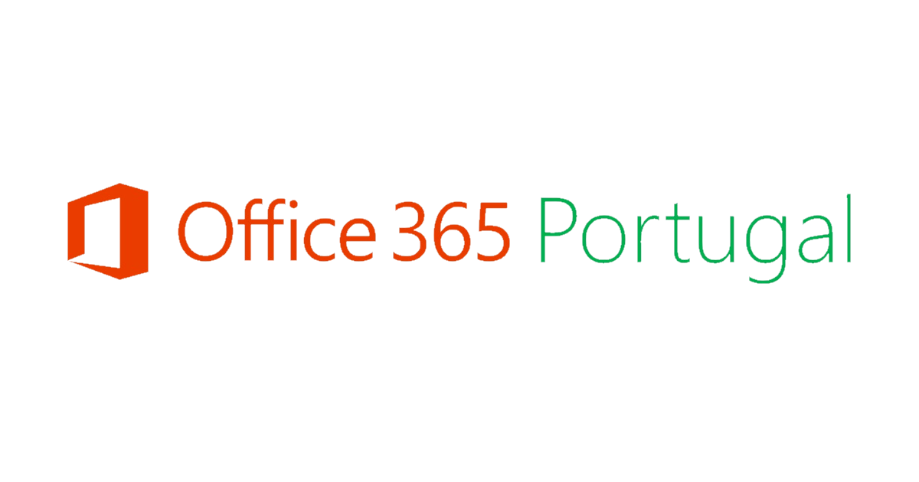

Our Sponsors
GOLD
COMMUNITY

Slide 3
Implementing an Event Sourcing strategy on Azure
Olena Borzenko
Eldert Grootenboer

Slide 4
Olena Borzenko & Eldert Grootenboer
Senior developer
@borzenko_lena
Motion10
Azure MVP
@egrootenboer

Slide 5
Event Sourcing

Slide 6
Event Sourcing
Order Created
Added 2 Shirts
Added 4 Hats
Shipping Info Added

Slide 7
Why use Event Sourcing?
CRUD
Locking data
Not easily scalable
Concurrency is difficult
No history
Notes:
Most applications work with data, and the typical approach is for the application to maintain the current state of the data by updating it as users work with it. For example, in the traditional create, read, update, and delete (CRUD) model a typical data process is to read data from the store, make some modifications to it, and update the current state of the data with the new values—often by using transactions that lock the data.
The CRUD approach has some limitations:
CRUD systems perform update operations directly against a data store, which can slow down performance and responsiveness, and limit scalability, due to the processing overhead it requires.
In a collaborative domain with many concurrent users, data update conflicts are more likely because the update operations take place on a single item of data.
Unless there's an additional auditing mechanism that records the details of each operation in a separate log, history is lost.

Slide 8
Event sourcing pattern
Write-heavy workloads
Inserts are more efficient
Built-in audit log
Don’t update objects
Notes:
Write-heavy workloads. Store each event as an immutable document, instead of updating state in-place
AddEventForObject(ObjectId, EventType, Timestamp)
GetEventsForObject(ObjectId, EventType)
GetEventsSinceTimestamp(Timestamp)
Why event-driven architectures?
Inserts are more efficient than update at scale
Built-in audit log of events
Decoupled micro-services that act on events
GetEventsForObject is a single-partition query to get latest state on read QUESTION from Olena: You mentioned before problems with scalability, can you tell us how it will work in this case?

Slide 9
Event Sourcing on Azure

Slide 10
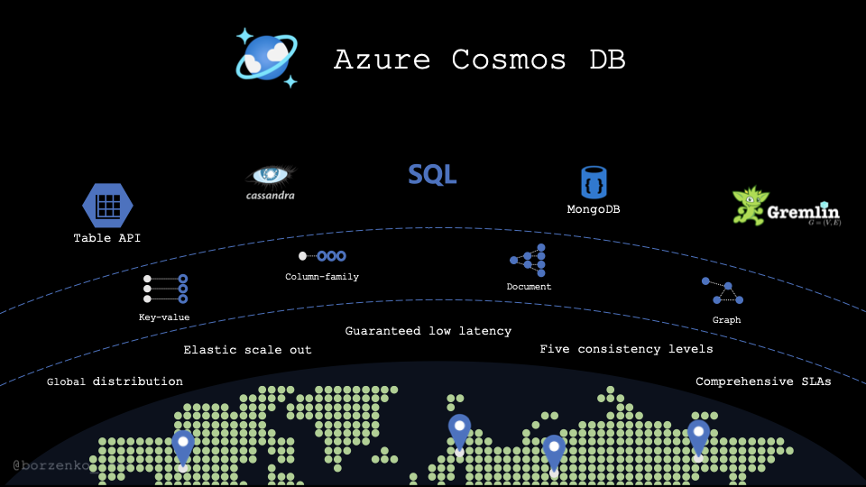
Event Sourcing on Azure
Cosmos DB
Event Hubs
Azure Functions
Notes:
Cosmos DB: Olena
Event Hubs: Eldert
Azure Functions: Olena

Slide 11




Demo time!
Notes:
Who here is working with Kafka?

Slide 12
Materialized view
Notes:
Why whould we use materialized view? In traditional way when we need to read our data we'd create a query and call it when we need it. With cosmosDB we might want to do it differently because our queries most likely will be quite expensuve. Especially when we have cross partition queries.

Slide 13
Creating a materialized view
More efficient querying
Pre-populated views
Update on change
Cosmos DB Change Feed
Notes:
Materialized View pattern. The data store used in a system based on event sourcing is typically not well suited to efficient querying. Instead, a common approach is to generate prepopulated views of the data at regular intervals, or when the data changes. Shows how this can be done.

Slide 14
Materializing Views
Application
Azure Cosmos DB
Materialized View
Order | User | Create Date | …
123abc | Ben6 | 6/17/17
456efg | Ben6 | 3/14/17
789hij | Jen4 | 8/1/16
012klm | Joe3 | 3/4/17
User | Total Orders
Ben6 | 2
Jen4 | 1
Joe3 | 1
Change feed
Notes:
QUESTION: We used to normalize all our data, to prevent duplication as much as possible. This, however, sounds like you will be duplicating data for your different views. Can you elaborate on this?

Slide 15

Demo time!

Slide 16
Almost done!

Slide 17
Key take-aways
Use the Azure eco-system for easy and powerful solutions
Cosmos DB is a great central append-only persistent data store
Prepare materialized views for various consumers
Use event-sourcing on Azure with heavy write loads
Notes:
Olena
Eldert
Olena
Eldert
Synapse

Slide 18
Our Sponsors
GOLD
COMMUNITY

Slide 19
Thank you!
@borzenko_lena
https://www.linkedin.com/in/olena-borzenko/
@egrootenboer
https://www.linkedin.com/in/eldert-grootenboer/

Slide 20


